Slide 1
Honeywell Home
E1 PRO
Thermostat

Slide 2
Technical Training

Slide 3
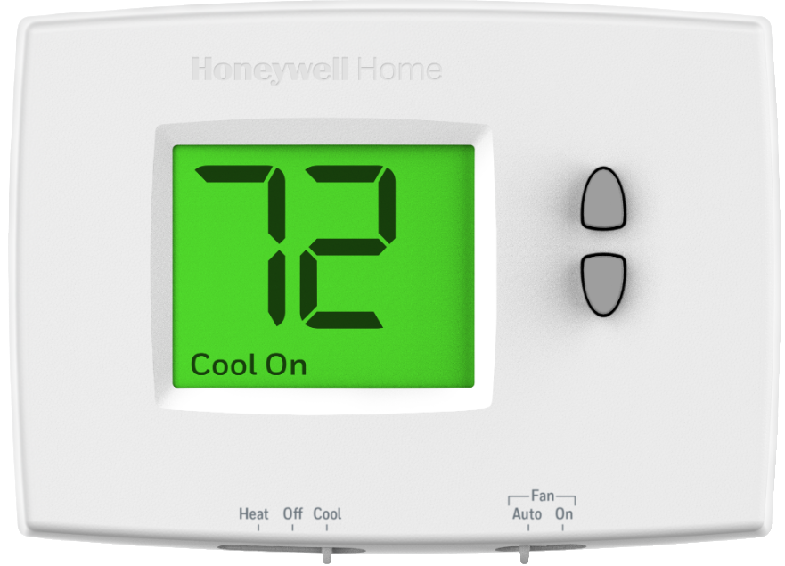
E1 PRO Thermostat
(Coming Summer of 2020)
TH1110E1000

Slide 4
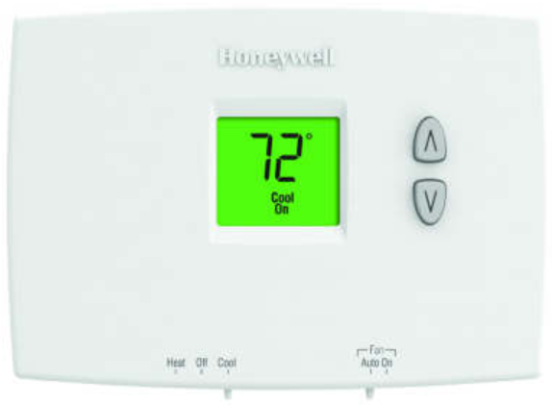
E1 PRO Thermostat
Same as the TH1110DH1003 but with a larger display
TH1110DH1003
1.32 sq. in. display
New TH1110E1000
2.38 sq. in. display

Slide 5

Same terminals as TH1110DH1003

Slide 6
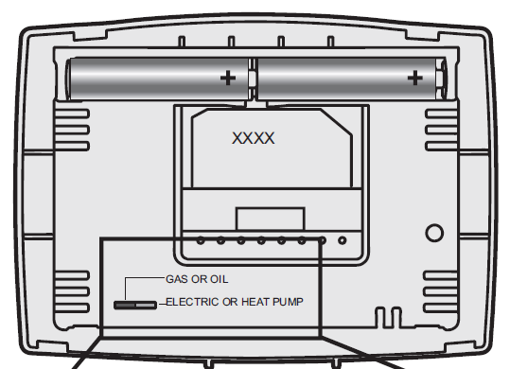

E1 PRO Thermostats Technical Information
Non-programmable (no schedule)
Model System
1 Heat + 1 Cool Conventional
Single Stage Heat Pump without Aux Heat
TH1110E1000
For heat pump without aux heat-
1. Jump W to Y
2. Set switch to Electric or heat pump.
3. Set heat cycle rate to 3.
Same as TH1110DH1003

Slide 7
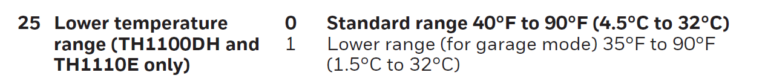
E1 PRO Thermostat Features
Model Features
Non-Programmable
Battery powered, hard-wired, or both
Low temperature setting for heat (35F)
TH1110E1000

Slide 8

Power Method Options
Can be battery powered or powered by Common.
C-Wire
Battery Powered

Slide 9
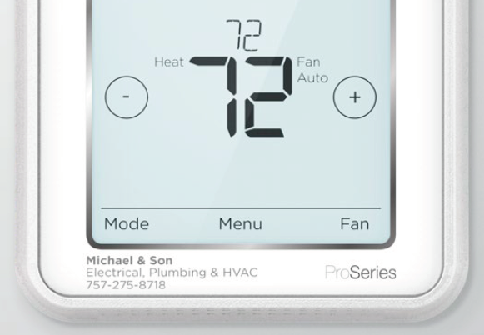
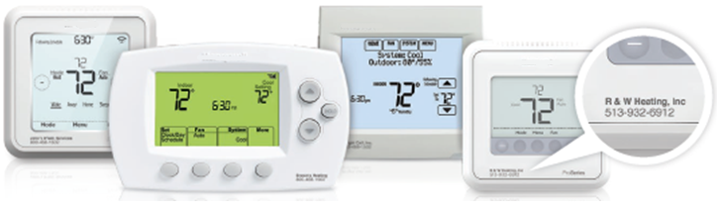
Eligible for Private Label Program
Customer to the Contractor
Drop ship to the Contractor – Freight Free
Associate your company name with the Honeywell Home Brand

Slide 10
Sales Training

Slide 11
WHO?

Slide 12
WHAT?

Slide 13
WHY?

Slide 14
WHERE?

Slide 15
WHEN?

Slide 16
HOW?

Slide 17
End of Training

